Slide 1
Title silde
.Task 4:Dashboard Design
.Name
.Internship

Slide 2
objective
Design an interactive dashboard for business stakeholders.
Kpls: sales,profit,Growth

Slide 3
Dataset
.Kaggle superstore dataset
.columns used:sales,profit, Growth,Category,Region,order date

Slide 4
Dashboard
Dashboard screenshot
KPls
Charts
Slicers

Slide 5
Insights
Total sales
Total profit
Best performaing category
Highest sales Region
Monthly sales trend

Slide 6
Conclusion
Dashboard helps track sales and profit
Filters make analysis easier.
Usuful for business decision_making

Slide 7
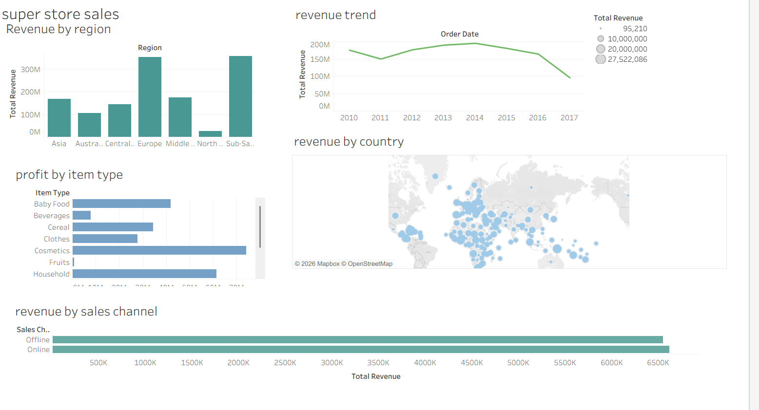
Dashboard superstore datasales

